Slide 1
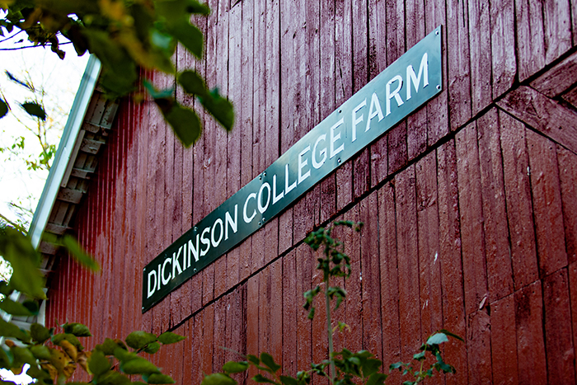
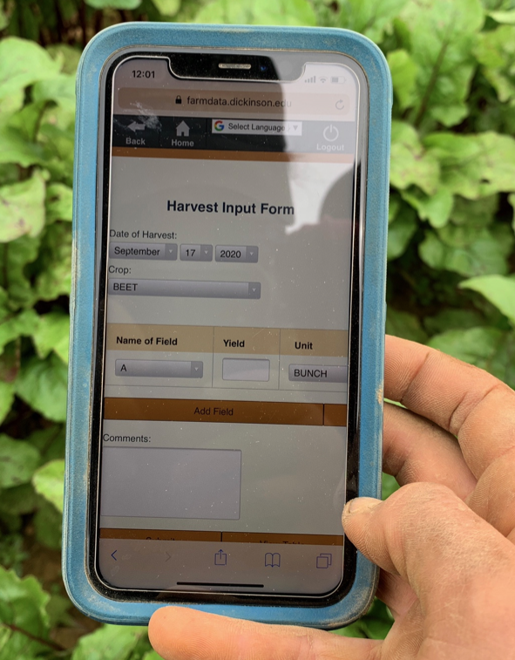
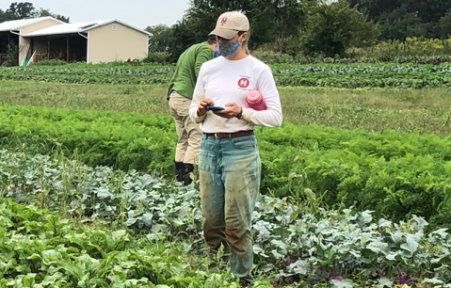
01 – Introduction and FarmData2 Install
COMP 290 – Dickinson College
Slides created by Prof. Braught
Edits by John MacCormick

Slide 2
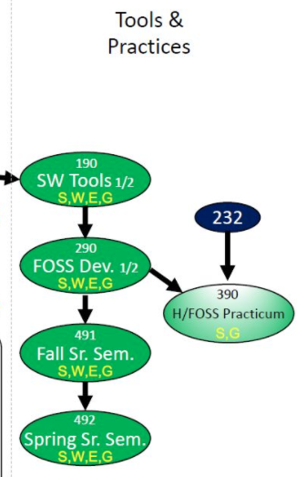
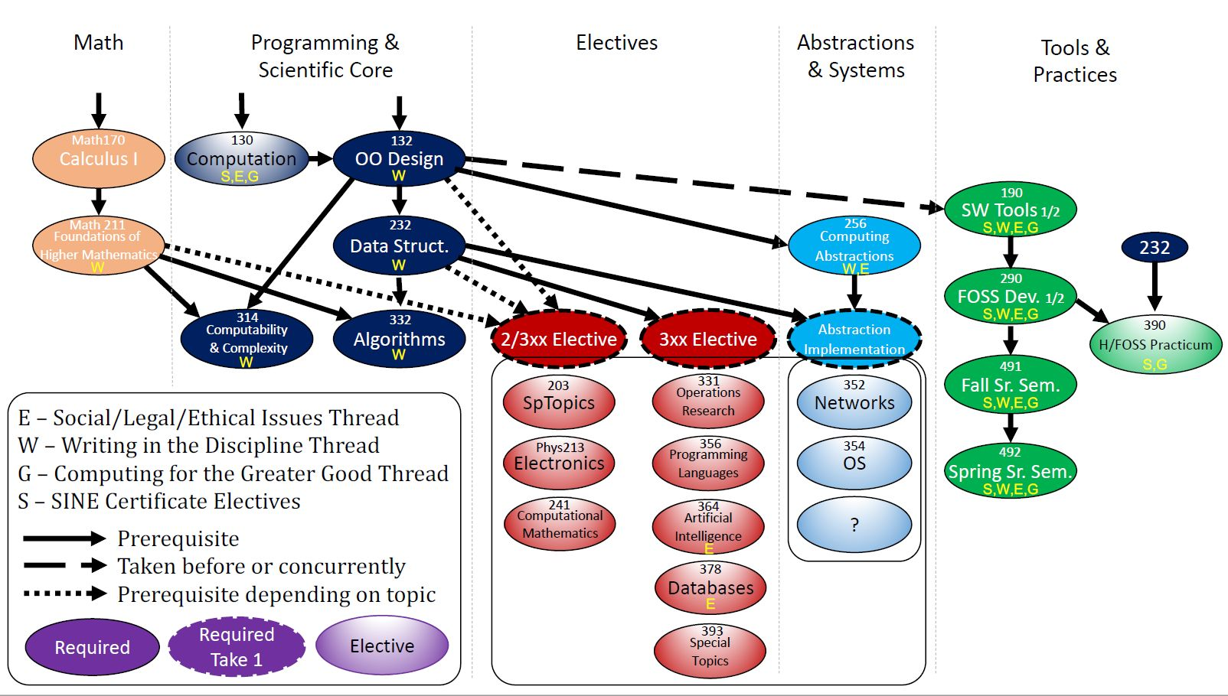
Curricular Context
Notes:
190…
- guided, detailed, building foundation, experience and skills
290
- You have those skills and experiences now.
- Shift to less specific more realistic experience of joining a project
- But with support of a class
- Provide experience of being part of a real project
- Real technologies, real tools, real users
- Similar to an internship or job experience in the classroom
- Great experience to tout in applying for internships
- If you are successful, will build GitHub resume too.
Preparation for 390 (if interested) and 491/492
- when you join and work on an H/FOSS project of interest
ALSO: S, W, E, G

Slide 3
290 Large-scale and Open Source Software Development
An introduction to large-scale software development through participation in a Humanitarian Free and Open Source Software (HFOSS) project. Readings and discussions will focus on FOSS and HFOSS philosophy, licensing, communication tools, project and community organization, and software engineering topics related to large-scale software development. Case studies of social, legal and ethical issues raised by computing and computing for the greater good will complement participation in the HFOSS project.
Notes:
Overarching goal is to have the experience of participating in a real-world project.
Real technologies, real tools, real clients and real users
That will be the central part of the course
- First half will be onboarding to the project
- learning the tools and technologies
- Improving independent leaning strategies for picking new things up on your own.
- Second half will be working in teams developing new features for the project.
Along with that…
- reading / discussions for breadth and perspective on FOSS and SWE
- readings for context (SLE / CGG)

Slide 4
Course Mechanics
Website
Moodle
GitHub
Zulip
Notes:
Do overall course structure:
- intro / foundations
- Tech spikes
- Here point out learning new things…
- Identify key technologies we’ll learn.
- Project work
Why Vue: Vue provides higher customizability and hence is easier to learn than Angular or React. Further, Vue has an overlap with Angular and React with respect to the functionality like the use of components. Hence, the transition to Vue from either of the two is an easy option.
Also FarmOS is moving toward greater Vue integration.

Slide 5
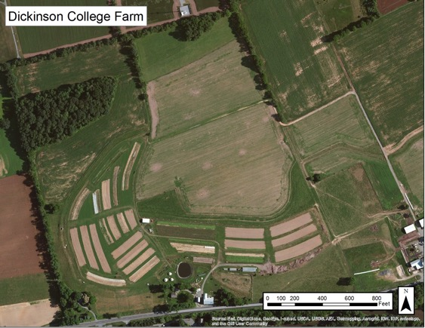
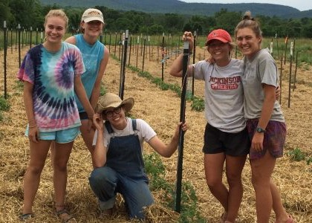
The Dickinson Farm
Dickinson’s College Farm is an 80-acre, USDA-certified organic farm and a living laboratory where students can gain distinctive, hands-on learning experiences.

Slide 6
FarmData History
Web-Based Mobile Database Applications to Support Organic Farming
FarmData: for entering and reporting crop production records, including seeding, transplanting, harvest, cover crop, compost, fertilization, irrigation, pest scouting, spray activities, packing and distribution records and customer invoicing.
AnimalData: for keeping livestock production records, from birth to slaughter or sale. Other data captured by the system includes pasture moves, periodic and veterinary care and logging of egg production.
Notes:
Works well,
- Two separate application and databases
- Older technology without good migration path or support personnel
- Combine and Update

Slide 7
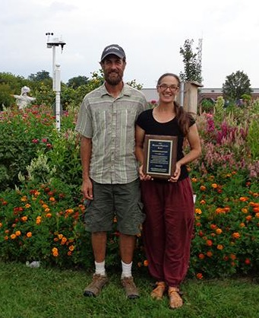
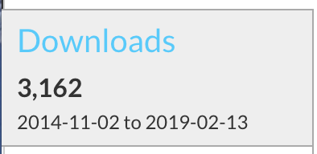
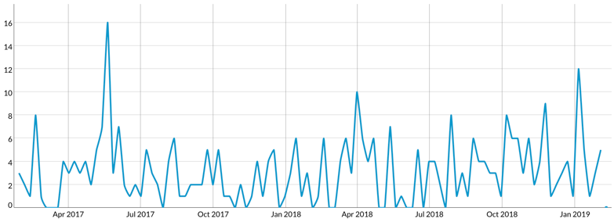
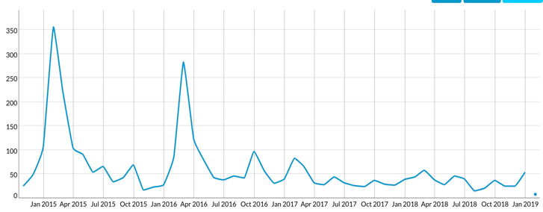
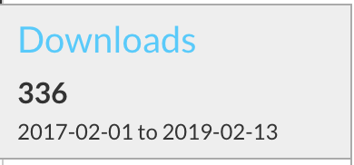
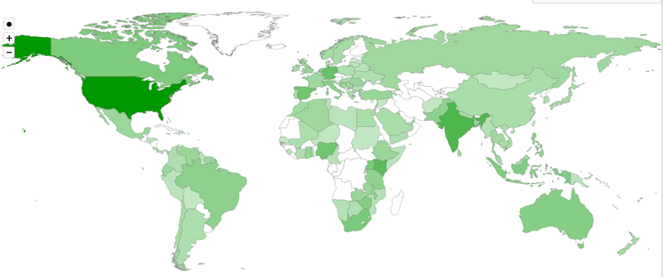
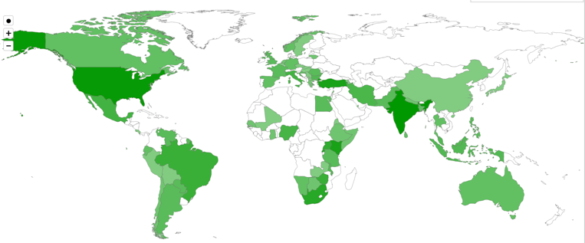
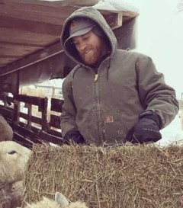
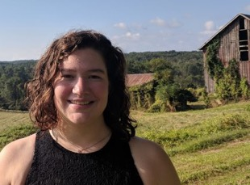
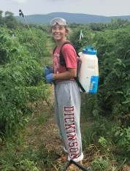
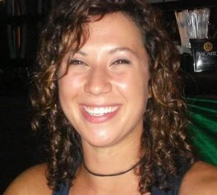
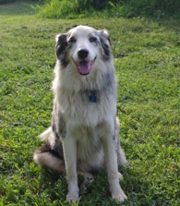
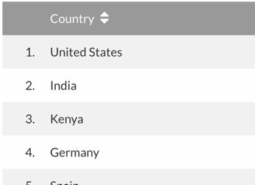
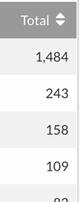
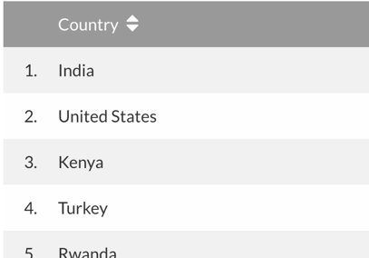
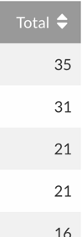
Local Clients, Global Communities
FarmData
AnimalData
Notes:
A little dated…. 2019
Matt (Farmer) & Jenn (Farm Manager)
Will (Veggies), Margaret (Education & Outreach), Kelsey (2nd Year Apprentice)
Jenn (Packing), Beh-ya (Pest Control)

Slide 8
Matt Steiman, Livestock and Energy Projects Manager
Matt has been farming organic vegetables since 1993, working on farms in Colorado, California and Minnesota before settling in the Cumberland Valley. For five seasons, Matt managed Fulton Farm at Wilson College where he learned the ropes of running an educational CSA program, and also developed initial experience with renewable energy systems. Matt and Jenn then ran their own farm on rented ground for two seasons before signing on as the full-time farmers at Dickinson College in 2007. In addition to regular farm duties at the Dickinson Farm, Matt supervises equipment maintenance, irrigation, sheep and cattle, and also works extensively with solar energy projects and biodiesel fuel applications for the college.

Slide 9

Installing FarmData2
In Activity you will follow INSTALL.md
You may still have this from COMP190. Options:
A) Come to it fresh
Delete Fork / VM / Local repo
Follow INSTALL.md
B) Synch with upstream
Check VM specs (RAM/Video Memory/Disk Space)
Do Linux updates (190 - A09)
Synch with upstream (190 – A08)
Confirm origin/local main matches upstream
Delete docker/db and docker/www directories
Pickup INSTALL.md at “Expand Sample Database Image”

Slide 10






Key features of your virtual machine
Disk size 30 GB
Main memory at least half of your own machine’s memory
Video memory 128 KB
“Guest additions” is installed
You can copy and paste from host to guest OS
You can run in full screen mode with Linux desktop occupying your entire screen.

Slide 11
What’s Next
Read Syllabus
Assignment FDS2
Due midnight Monday
Reading Assignment
Have one thing you found interesting ready to raise for discussion during next class.

Slide 12

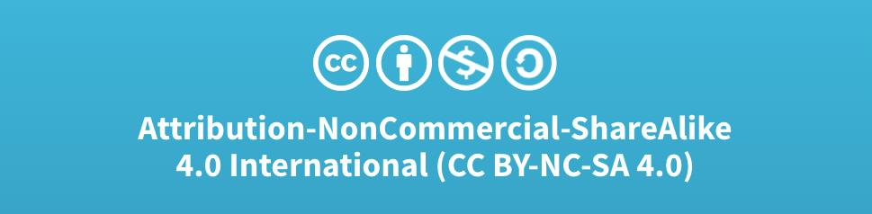
Acknowledgments:
Slide Template From:
https://creativecommons.org/licenses/by/4.0/
Slide Content Licensed as:
Creative Commons Attribution-NonCommercial-ShareAlike 4.0 International License.

